Slide 1





Interest Calculations

Slide 2
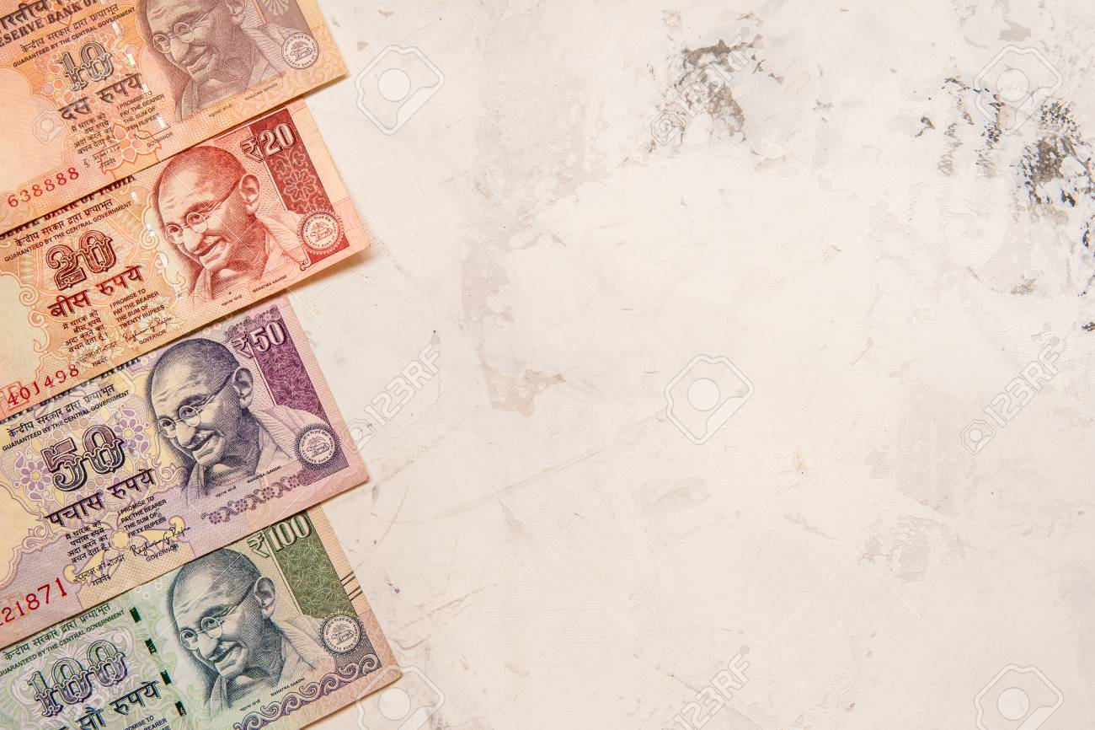




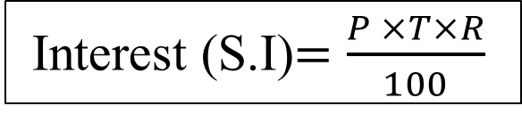
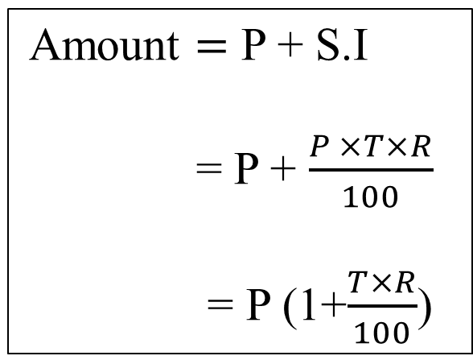
A = P + S.I
If the interest on a sum borrowed is reckoned uniformly, for a certain period, then it is called as simple interest.
Principal (P): It is the money borrowed or lent out for a certain period of time.
Interest (R): Rate of money paid regularly for using money on lent. The extra money paid by the borrower to the lender is called the interest. Interest is defined as rate (R) per cent per annum (p.c.p.a.).
Time period (T): The duration for which the money is borrowed / deposited.
It is calculated per year , if months is given divide by 12, if days is given divide by 365.
Total amount (A) : Sum of principal and simple interest.
SIMPLE INTEREST
Interest (S.I)$=\frac{P ×T×R}{100}$
Amount $=$ P + S.I
= P + $\frac{P ×T×R}{100}$
= P (1+$\frac{T×R}{100}$)

Slide 3
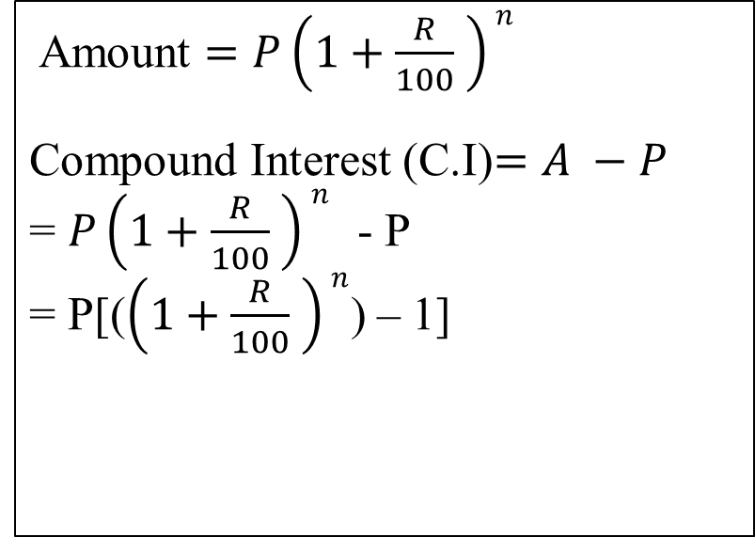
A = P + S.I
Compound Interest is the interest calculated on the initial principal and the accumulated interest of previous periods of a deposit or loan. In easy words, it can be said as "interest on interest".
Principal (P): It is the money borrowed or lent out for a certain period of time.
Interest (R): Rate of money paid regularly for using money on lent. The extra money paid by the borrower to the lender is called the interest. Interest is defined as rate (R) per cent per annum (p.c.p.a.).
Time period (T): The duration for which the money is borrowed / deposited.
It is calculated per year , if months is given divide by 12, if days is given divide by 365.
Total amount (A) : Sum of principal and simple interest.
COMPOUND INTEREST
Compound Interest is the interest calculated on the initial principal and the accumulated interest of previous periods of a deposit or loan. In easy words, it can be said as "interest on interest".
Amount $=P\left(1+\frac{R}{100} \right)n$
Compound Interest (C.I)$=A −P$
= $P\left(1+\frac{R}{100} \right)n$ - P
= P[($\left(1+\frac{R}{100} \right)n$) – 1]

Slide 4
A = P + S.I
If 25,000 is deposited under simple interest and compound interest at 10% p.a for 4 years. What will be difference between their interest?
Compound Interest is the interest calculated on the initial principal and the accumulated interest of previous periods of a deposit or loan. In easy words, it can be said as "interest on interest".
SIMPLE INTEREST Rs.25000
COMPOUND INTEREST Rs.25000
Year | Interest | Interest
I | 10% of 25000 = 2500 | 10% of 25000 = 2500
II | 10% of 25000 = 2500 | 10% of 25000 + 10% of 2500 = 2500+250 = 2750
III | 10% of 25000 = 2500 | 10% of 25000 + 10% of 2500 +10% of 2500+ 10% of 250 = 2500+250+250+25 = 3025
IV | 10% of 25000 = 2500 | 10% of 25000 + 10% of 2500 + 10% of 2500 + 10% of 2500 + 10% of 250+ 10% of 250 + 10% of 250+ 10% of 25 = 2500+250+250+250+25+25+25+2.5 = 3327.5
 |  | 2500+2750+3025+3327.5 = 11602.5
Total | 40% of 25000 = Rs.10000 | Rs.11602.50 (approx 46.41%)

Slide 5
Problems based on Doubling, Tripling , etc (SIMPLE INTEREST):
Example:
A sum of money invested at simple interest triples itself in 8 years at simple interest. Find in how many years will it become 9 times itself at the same rate?
Logical Explanation:
Let the amount invested be ‘P’.
Amount = P + S.I
Years | Interest (S.I) | Amount (P+S.I)
8 | 2P | 3P
16 | 4P | 5P
24 | 6P | 7P
32 | 8P | 9P
40 | 10P | 11P
48 | 12P | 13P
Amount = P + S.I
Given Amount becomes triples in 8 years. so
A = 3P
3P = P + S.I
S.I = 2P
So,
Since it becomes 2P in 8 years it will become 4P in 16 years , 6P in 24 years , 8P in 32 years.
If S.I = 8P then the amount will be 9P in 32 years.

Slide 6
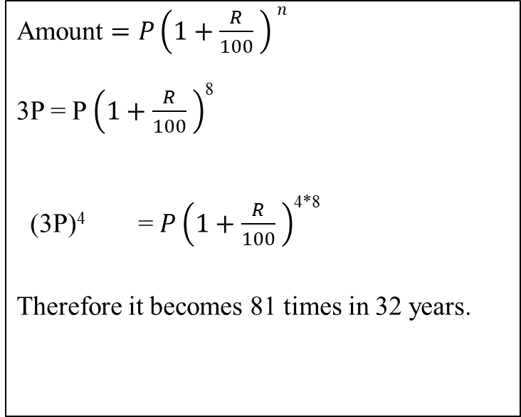
Problems based on Doubling, Tripling , etc (COMPOUND INTEREST):
Example:
A sum of money invested at Compound interest triples itself in 8 years . Find how many times will it become at the end of 32 years at the same rate?
Problems based on Doubling, Tripling (COMPOUND INTEREST):
Example:
A sum of money invested at compound interest triples itself in 8 years. Find how many times will it become at the end of 32 years at the same rate?
Let the amount invested be ‘P’.
Amount $=P\left(1+\frac{R}{100} \right)n$
3P = P $\left(1+\frac{R}{100} \right)$⁸
(3P)⁴ = $P\left(1+\frac{R}{100} \right)$^{4*8}
Therefore it becomes 81 times in 32 years.
Years | Amount
8 years | 3 times P
16 years | 9 times P
24 years | 27 times P
32 Years | 81 times P

Slide 7

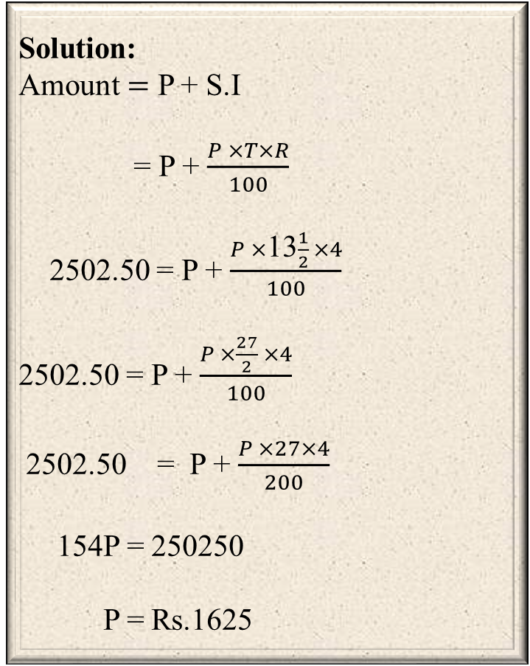
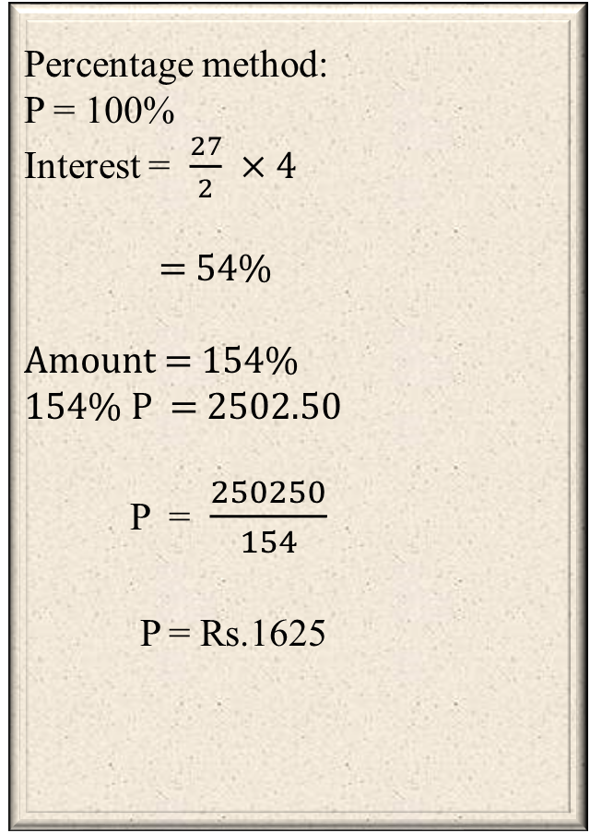
A = P + S.I
A sum at simple interest at 13$\frac{1}{2}$ % per annum amounts to Rs.2502.50 after 4 years. Find the sum.
Compound Interest is the interest calculated on the initial principal and the accumulated interest of previous periods of a deposit or loan. In easy words, it can be said as "interest on interest".
Solution:
Amount $=$ P + S.I
= P + $\frac{P ×T×R}{100}$
2502.50 = P + $\frac{P ×\text{13}\frac{1}{2} ×4}{100}$
2502.50 = P + $\frac{P ×\frac{27}{2} ×4}{100}$
2502.50 = P + $\frac{P ×27×4}{200}$
154P = 250250
P = Rs.1625
Percentage method:
P = 100%
Interest = $\frac{27}{2} ×4$
= 54%
Amount = 154%
154% P = 2502.50
P = $\frac{250250}{154}$
P = Rs.1625
OR

Slide 8
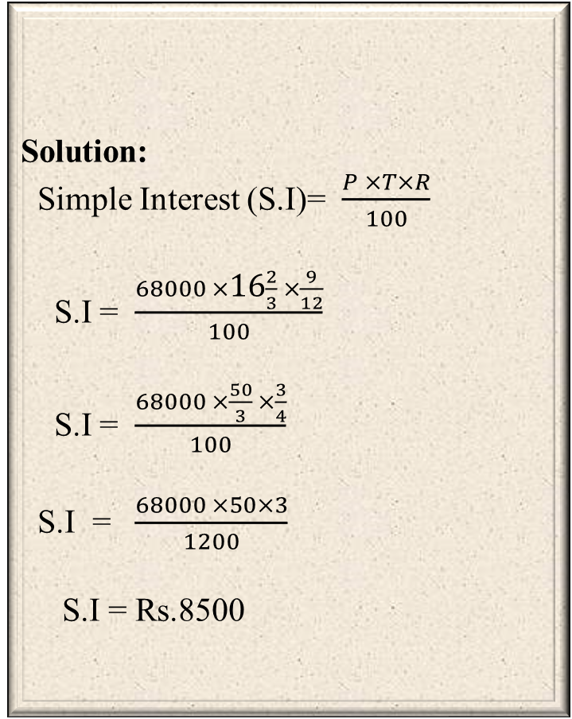
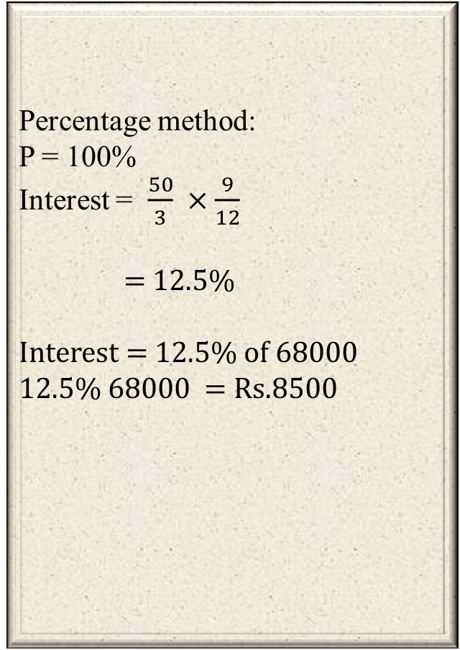
A = P + S.I
Find the simple interest on Rs. 68000 at 16 $\frac{2}{3}$% per annum for 9 months.
Compound Interest is the interest calculated on the initial principal and the accumulated interest of previous periods of a deposit or loan. In easy words, it can be said as "interest on interest".
Solution:
Simple Interest (S.I)= $\frac{P ×T×R}{100}$
S.I = $\frac{68000 ×\text{16}\frac{2}{3} ×\frac{9}{12}}{100}$
S.I = $\frac{68000 ×\frac{50}{3} ×\frac{3}{4}}{100}$
S.I = $\frac{68000 ×50×3}{1200}$
S.I = Rs.8500
Percentage method:
P = 100%
Interest = $\frac{50}{3} ×\frac{9}{12}$
= 12.5%
Interest = 12.5% of 68000
12.5% 68000 = Rs.8500
OR

Slide 9
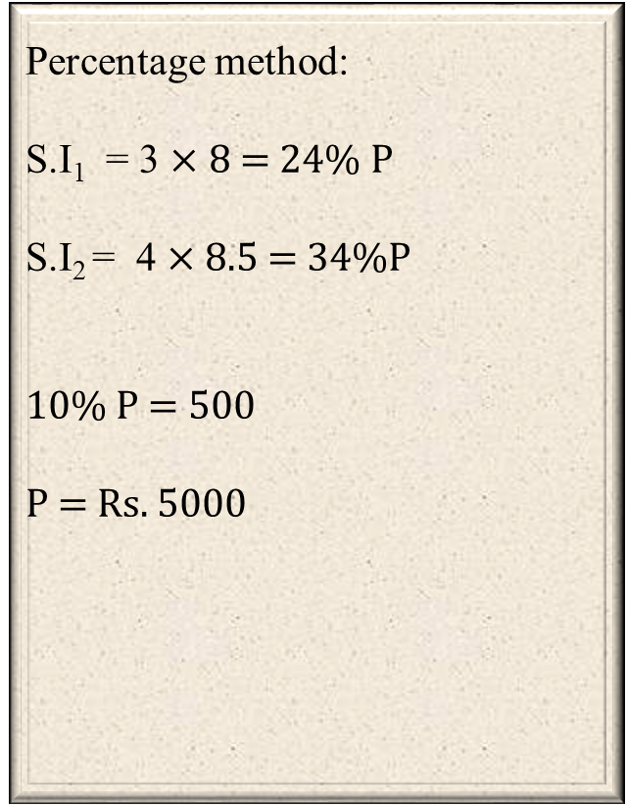
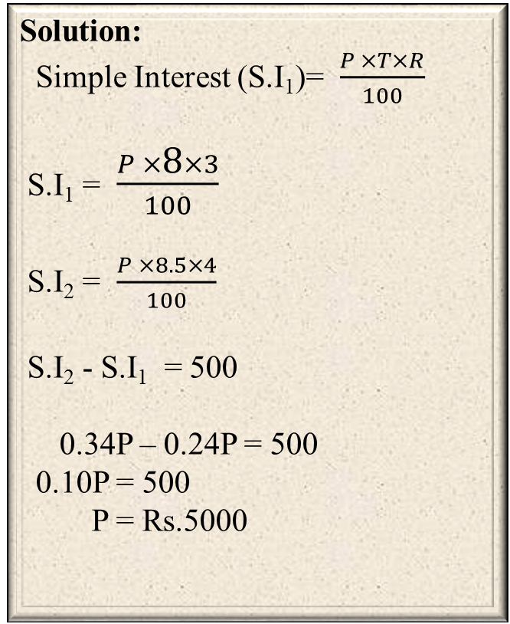
A = P + S.I
A sum of money was invested in a bank at 8% p.a. simple interest for three years. Instead
had it been invested in mutual fund at 8.5% p.a. simple interest for four years, the earnings would have been Rs. 500 more. What is the sum invested?.
Compound Interest is the interest calculated on the initial principal and the accumulated interest of previous periods of a deposit or loan. In easy words, it can be said as "interest on interest".
Solution:
Simple Interest (S.I₁)= $\frac{P ×T×R}{100}$
S.I₁ = $\frac{P ×\text{8}×3}{100}$
S.I₂ = $\frac{P ×8.5×4}{100}$
S.I₂ - S.I₁ = 500
0.34P – 0.24P = 500
0.10P = 500
P = Rs.5000
Percentage method:
S.I₁ = 3 $×$ 8 = 24% P
S.I₂ = 4 $×$ 8.5 = 34%P
10% P = 500
P = Rs. 5000
OR

Slide 10
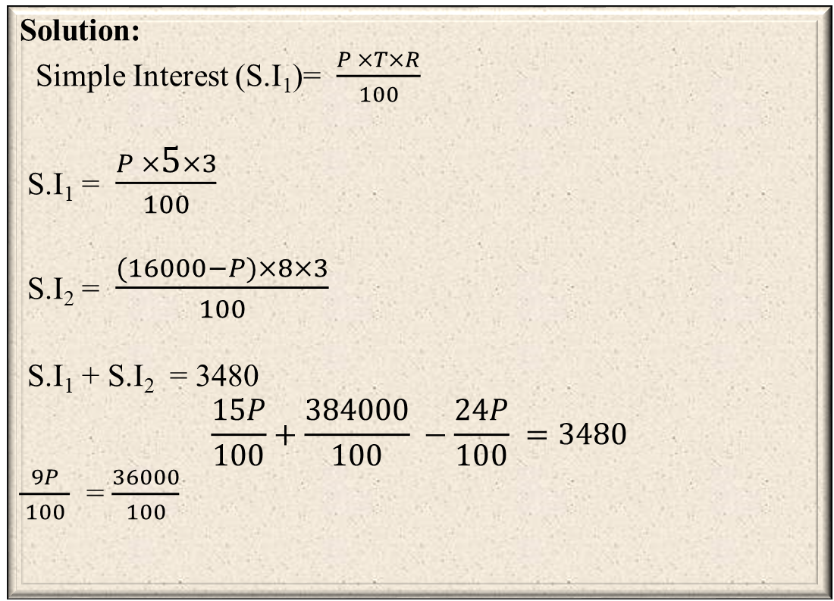
A = P + S.I
Rs. 16000 was invested for three years, partly in scheme A at the rate of 5% simple interest per annum and partly in scheme B at the rate of 8% simple interest per annum. The total interest received at the end was Rs. 3480. What amount of money was invested in scheme A ?
Compound Interest is the interest calculated on the initial principal and the accumulated interest of previous periods of a deposit or loan. In easy words, it can be said as "interest on interest".
Solution:
Simple Interest (S.I₁)= $\frac{P ×T×R}{100}$
S.I₁ = $\frac{P ×\text{5}×3}{100}$
S.I₂ = $\frac{(16000−P)×8×3}{100}$
S.I₁ + S.I₂ = 3480
$$\frac{15P}{100}+\frac{384000}{100} −\frac{24P}{100} =3480$$
$\frac{9P}{ 100 }$ = $\frac{36000}{100}$
9P = 36000
P = 4000
Answer: Rs.4000

Slide 11
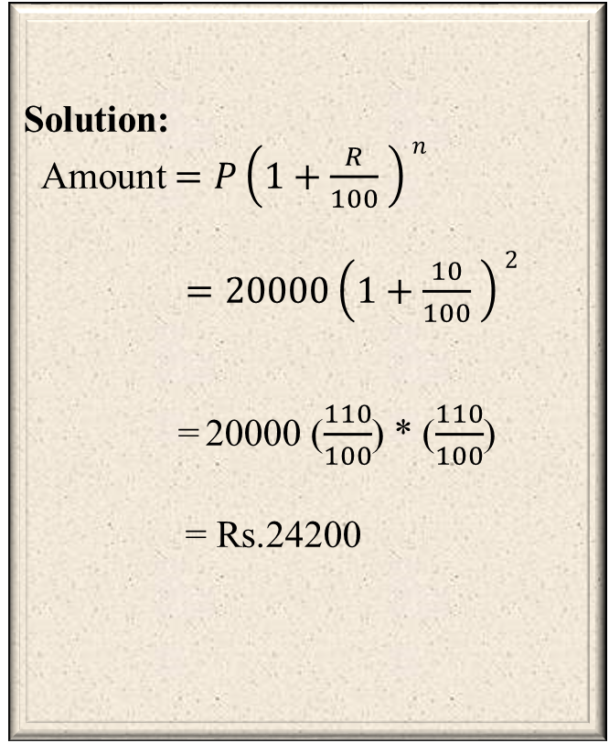
A = P + S.I
Find the amount obtained by investing Rs.20,000 at 10% p.a. compound interest for
two years, compounded annually?
Compound Interest is the interest calculated on the initial principal and the accumulated interest of previous periods of a deposit or loan. In easy words, it can be said as "interest on interest".
Solution:
Amount $=P\left(1+\frac{R}{100} \right)n$
$=20000\left(1+\frac{10}{100} \right)2$
= 20000 ($\frac{110}{100}$) * ($\frac{110}{100}$)
= Rs.24200
Total C.I = 4200
Amount = P+C.I
= 20000+4200
= Rs. 24200
COMPOUND INTEREST Rs.20000
Interest
10% of 20000 = 2000
10% of 20000 + 10% of 2000 = 2000+200 = 2200
OR

Slide 12
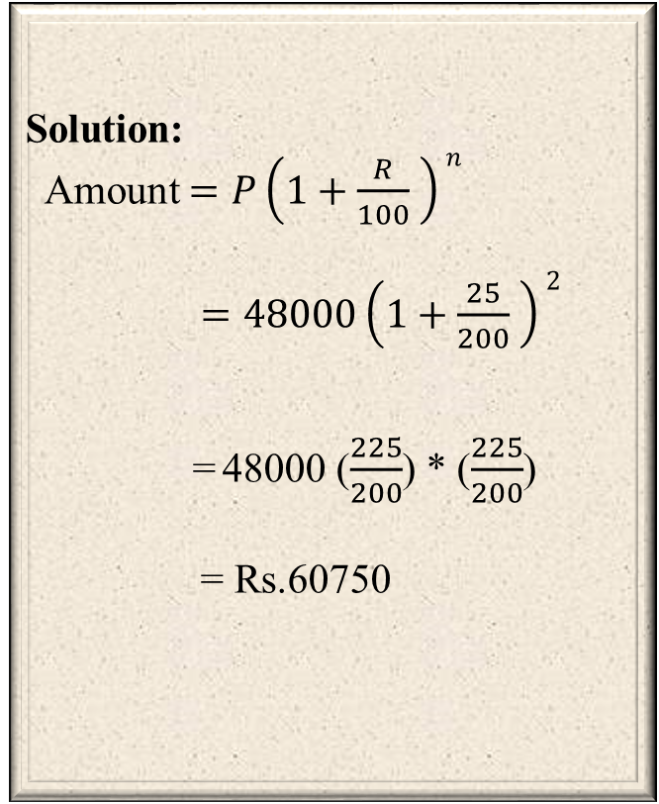
A = P + S.I
Find the amount obtained by investing Rs.48000 at 25% p.a. compound interest, for
one year, compounded half yearly?
Compound Interest is the interest calculated on the initial principal and the accumulated interest of previous periods of a deposit or loan. In easy words, it can be said as "interest on interest".
Solution:
Amount $=P\left(1+\frac{R}{100} \right)n$
$=48000\left(1+\frac{25}{200} \right)2$
= 48000 ($\frac{225}{200}$) * ($\frac{225}{200}$)
= Rs.60750
Total C.I = 12750
Amount = P+C.I
= 48000+12750
= Rs. 60750
COMPOUND INTEREST Rs.48000
Interest
12.5% of 48000 = 6000
12.5% of 48000 + 12.5% of 6000 = 6000+750 = 6750
OR

Slide 13
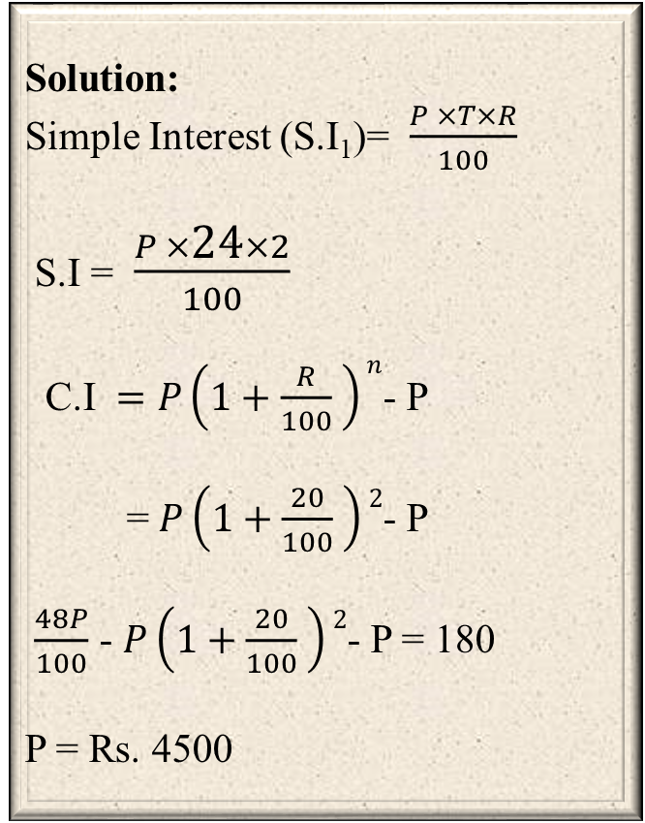
A = P + S.I
A sum lent at 24% p.a. simple interest yields Rs. 180 more interest than when lent at 20% p.a. compound interest in two years. Find the sum.
Compound Interest is the interest calculated on the initial principal and the accumulated interest of previous periods of a deposit or loan. In easy words, it can be said as "interest on interest".
Solution:
Simple Interest (S.I₁)= $\frac{P ×T×R}{100}$
S.I = $\frac{P ×\text{24}×2}{100}$
C.I $=P\left(1+\frac{R}{100} \right)n$- P
= $P\left(1+\frac{20}{100} \right)2$- P
$\frac{48P}{100}$ - $P\left(1+\frac{20}{100} \right)2$- P = 180
P = Rs. 4500
C.I = 0.44P
S.I = 0.48P
0.04P = 180
P = Rs.4500
COMPOUND INTEREST Rs.P
Interest
20% of P = 0.2P
20% of P + 20% of 0.2P = 0.2P+0.04P = 0.24P
OR

Slide 14
At simple interest a sum doubles itself in twelve years. In how many years does it become six times itself?
Logical Explanation:
Let the amount invested be ‘P’.
Amount = P + S.I
Amount = P + S.I
Given Amount becomes double in 12 years. so
A = 2P
2P = P + S.I
S.I = P
So, Since it becomes 2P in 24 years it will become 3P in 36 years , 4P in 48 years , 5P in 60 years.
If S.I = 5P then the amount will be 6P in 60 years.
Years | Interest (S.I) | Amount (P+S.I)
12 | P | 2P
24 | 2P | 3P
36 | 3P | 4P
48 | 4P | 5P
60 | 5P | 6P

Slide 15



